Slide 1
MEC 402 Casting, Welding and Forming
Dr. Arjyajyoti Goswami
arjyajyoti.Goswami@me.nitdgp.ac.in
+91-9953167384

Slide 2
Gas Welding :
Definition of gas welding
Salient parts of Gas Welding machine
Operating a gas welding machine
Types of flames and their characteristics
Carburizing
Neutral
Oxidizing
Leftward vs rightward Technique

Slide 3
Gas Welding :
Gas Welding is fusion welding process that joins metals by melting them with the heat derived from the combustion of fuel in combination with oxygen.
If the fuel is Acetylene - Oxy Acetylene Welding (most common form)
If the fuel is Air - Oxy Air Welding.
If no fuel is used and it is done in vacuum – Oxy Welding
The heat produced by combustion is in the order of 3200°C and as such is sufficient to melt ‘any’ metal.

Slide 4
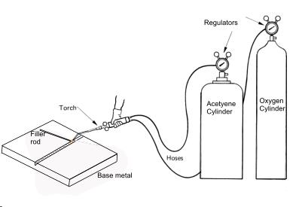
Parts of gas welding machine :
Cylinders
Pressure regulators
Hoses
Torch
https://www.samsfabrications.co.uk/useful-tools/welding-processes/

Slide 5
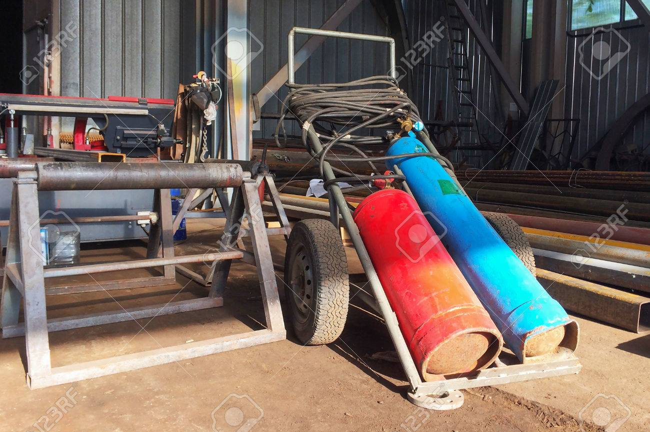
https://www.123rf.com/photo_82403731_gas-welding-equipment-and-band-saw-in-the-assembly-shop.html

Slide 6
Cylinders :
Oxygen and Acetylene cylinder. The acetylene cylinder (16kg/cm2) is short while oxygen cylinder (125 kg/cm2) is long.
Regulators:
The gas is at high pressure inside the cylinder so a pressure regulator is provided at the opening valve of the cylinder, so that the pressure can be brought down. Oxygen at 1 kg/cm2 and C2H2 at 0.15 kg/cm2.
The flow rate of the gases can be seen from the pressure gauges, provided with the regulators.
Hoses are for carrying the gas from cylinder till the welding torch, where the gases mix and are ultimately ignited for the welding.

Slide 7
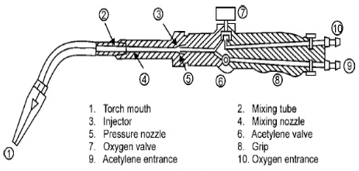
Gas Welding Torch
https://www.slideshare.net/AkhileshwarNirala/gas-welding-72453808

Slide 8
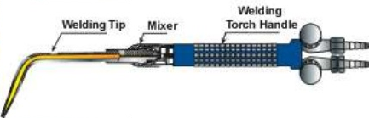
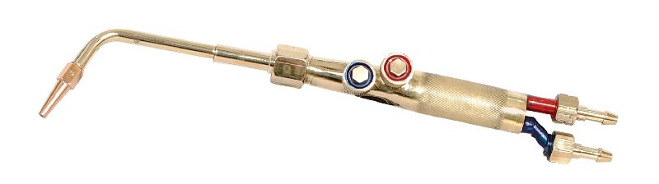
https://www.slideshare.net/AkhileshwarNirala/gas-welding-72453808
https://www.exportersindia.com/cruser-enterprises-company4477255/german-type-gas-welding-torch-4926994.htm

Slide 9
End tip configuration for Gas Welding and Gas Cutting Torch
Gas Welding Torch
Gas Cutting Torch
One opening. Mixture comes out
Oxygen from centre, fuel from the periphery.

Slide 10
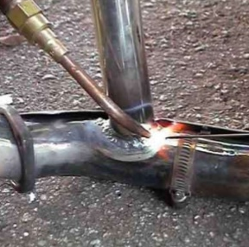
Operating the gas welding machine
Open the acetylene control valve and wait for sometime for the gases to be flushed.
Using the ignitor start ignition. At this stage some amount of smoke is visible in the flame.
The acetylene control valve is then adjusted to stop the smoke.
Now the oxygen control valve is opened and adjusted to control the proportion of oxygen in the flame as per requirement.
https://www.slideshare.net/AkhileshwarNirala/gas-welding-72453808

Slide 11
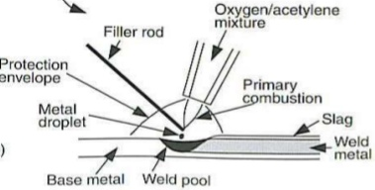
Welding zone in Gas Welding

Slide 12
Types of flames

Slide 13
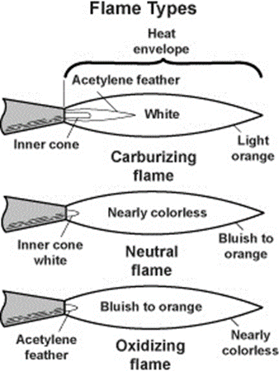
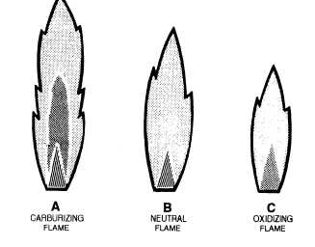
Decreasing order of length and increasing order of temperature

Slide 14
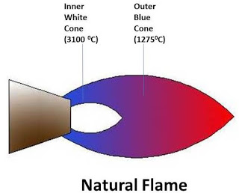
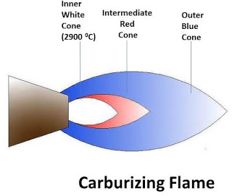
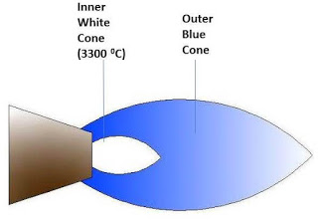
Carburizing flame
Neutral flame
Oxidizing flame

Slide 15
Some specific topics
Oxidizing flame is suitable for welding of brass. Brass is an alloy of Copper and Zinc. The oxygen of the flame reacts with the Cu to form Copper Oxides which prevents the Zn in the alloy to fume away. This retains the property and fidelity of the joint.
During welding of steel the excess carbon combine with carbon to form Iron Carbides. Normally presence of iron carbides makes the weld unsuitable for application. Hence carburizing flame is mostly used for welding of lead and its associated alloys, non-ferrous metals that do not absorb carbon. But it is majorly used for surface hardening processes.
In all flame types there are 2 zones, but in Carburizing flames there are three zones. There is a middle zone called Acetylene Feather, which is the excess carbon present in the flame.

Slide 16
Leftward vs Rightward technique

Slide 17
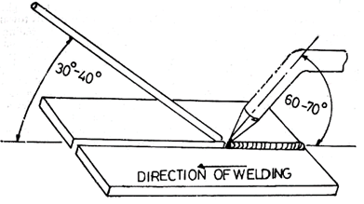
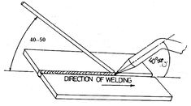
Leftward Technique | Rightward Technique
Welder holds welding torch in his right hand and filler rod in his left hand. The weld progresses from right to left. It is started on the right side and progresses towards the left of the joint. | Welder holds the welding torch in his right hand and the filler rod in his left hand. The weld progresses from left to right. It is started on the left end of the joint and progresses towards the right side of the joint.

Slide 18
Leftward Technique | Rightward Technique
The welding flame is directed away from finished weld and towards the direction of the welding. Thus it results in pre-heating of the joint. The flame is between the finished weld and the filler rod. | The direction of torch is towards the completed weld and the filler rod is in between the flame and the finished weld.
Welding torch is given sideways movement while the filler rod is moved backward and forward. | The welding rod need not be given any movement while the filler rod is given circular movement (within the weld puddle).
Used on relatively thin sheets less than 5mm. For higher thickness (even for 6.5mm) it is difficult to achieve the melting at the bottom. Also in leftward technique the view of the joint is blocked so the welding maybe needed to be stopped sometime in between, which may result in formation of oxide at the tip of the filler rod which can get deposited into the weld | The rightward technique is more suitable for heavier or thicker base metals (thickness greater than 5mm) because in this heat is concentrated in the base metal and hence higher penetrations can be achieved through this type of welding.

